Slide 1
A Machine Learning Model for Average Fuel Consumption in Heavy Vehicles
Under The Guidance Of Presented By
M.Chaitanya Mam B.Hari Priya
Asst.Professor Roll no: L19CA124

Slide 2
ABSTRACT
This paper advocates a data summarization approach based on distance rather than the traditional time period when developing individualized machine learning models for fuel consumption. This approach is used in conjunction with seven predictors derived from vehicle speed and road grade to produce a highly predictive neural network model for average fuel consumption in heavy vehicles.
The proposed model can easily be developed and deployed for each individual vehicle in a fleet in order to optimize fuel consumption over the entire fleet. The predictors of the model are aggregated over fixed window sizes of distance traveled. Different window sizes are evaluated and the results show that a 1 km window is able to predict fuel consumption with a 0.91 coefficient of determination and mean absolute peak-to-peak percent error less than 4% for routes that include both city and highway duty cycle segments.

Slide 3
EXISTING SYSTEM
Physics-based models, which are derived from an in-depth understanding of the physical system. These models describe the dynamics of the components of the vehicle at each time step using detailed mathematical equations.
Machine learning models, which are data-driven and represent an abstract mapping from an input space consisting of a selected set of predictors to an output space that represents the target output, in this case average fuel consumption.
Statistical models, which are also data-driven and establish a mapping between the probability distribution of a selected set of predictors and the target outcome.

Slide 4
SCOPE
Model that can be easily developed for individual heavy vehicles in a large fleet is proposed. Relying on accurate models of all of the vehicles in a fleet, a fleet manager can optimize the route planning for all of the vehicles based on each unique vehicle predicted fuel consumption thereby ensuring the route assignments are aligned to minimize overall fleet fuel consumption.

Slide 5
PROPOSED SYSTEM
Data is collected at a rate that is proportional to its impact on the outcome. When the input space is sampled with respect to time, the amount of data collected from a vehicle at a stop is the same as the amount of data collected when the vehicle is moving.
The predictors in the model are able to capture the impact of both the duty cycle and the environment on the average fuel consumption of the vehicle (e.g., the number of stops in an urban traffic over a given distance).
Data from raw sensors can be aggregated on-board into few predictors with lower storage and transmission bandwidth requirements. Given the increase in computational capabilities of new vehicles, data summarization is best performed on-board near the source of the data.
New technologies such as V2I and dynamic traffic management can be leveraged for additional fuel efficiency optimization at the level of each specific vehicle, route and time of day.

Slide 6
ADVANTAGES OF PROPOSED SYSTEM:
Data is collected at a rate that is proportional to its impact on the outcome. When the input space is sampled with respect to time, the amount of data collected from a vehicle at a stop is the same as the amount of data collected when the vehicle is moving.
The predictors in the model are able to capture the impact of both the duty cycle and the environment on the average fuel consumption of the vehicle (e.g., the number of stops in an urban traffic over a given distance).
Data from raw sensors can be aggregated on-board into few predictors with lower storage and transmission bandwidth requirements. Given the increase in computational capabilities of new vehicles, data summarization is best performed on-board near the source of the data.

Slide 7
Modules Used in Project
Tensorflow
TensorFlow is a free and open-source software library for dataflow and differentiable programming across a range of tasks. It is a symbolic math library, and is also used for machine learning applications such as neural networks. It is used for both research and production at Google.‍
TensorFlow was developed by the Google Brain team for internal Google use. It was released under the Apache 2.0 open-source license on November 9, 2015

Slide 8
Numpy
Numpy is a general-purpose array-processing package. It provides a high-performance multidimensional array object, and tools for working with these arrays.
It is the fundamental package for scientific computing with Python. It contains various features including these important ones:
A powerful N-dimensional array object
Sophisticated (broadcasting) functions
Tools for integrating C/C++ and Fortran code
Useful linear algebra, Fourier transform, and random number capabilities
Besides its obvious scientific uses, Numpy can also be used as an efficient multi-dimensional container of generic data. Arbitrary data-types can be defined using Numpy which allows Numpy to seamlessly and speedily integrate with a wide variety of databases.

Slide 9
Pandas
Pandas is an open-source Python Library providing high-performance data manipulation and analysis tool using its powerful data structures. Python was majorly used for data munging and preparation. It had very little contribution towards data analysis. Pandas solved this problem. Using Pandas, we can accomplish five typical steps in the processing and analysis of data, regardless of the origin of data load, prepare, manipulate, model, and analyze. Python with Pandas is used in a wide range of fields including academic and commercial domains including finance, economics, Statistics, analytics, etc.

Slide 10
Matplotlib
Matplotlib is a Python 2D plotting library which produces publication quality figures in a variety of hardcopy formats and interactive environments across platforms. Matplotlib can be used in Python scripts, the Python and IPython shells, the Jupyter Notebook, web application servers, and four graphical user interface toolkits. Matplotlib tries to make easy things easy and hard things possible. You can generate plots, histograms, power spectra, bar charts, error charts, scatter plots, etc., with just a few lines of code. For examples, see the sample plots and thumbnail gallery.
For simple plotting the pyplot module provides a MATLAB-like interface, particularly when combined with IPython. For the power user, you have full control of line styles, font properties, axes properties, etc, via an object oriented interface or via a set of functions familiar to MATLAB users.

Slide 11
Scikit – learn
Scikit-learn provides a range of supervised and unsupervised learning algorithms via a consistent interface in Python. It is licensed under a permissive simplified BSD license and is distributed under many Linux distributions, encouraging academic and commercial use. Python

Slide 12
Dataset Design
num_stops
time_stopped
average_moving_speed
characteristic_acceleration
aerodynamic_speed_squared
change_ in_kinetic_energy
change_in_potential_energy

Slide 13
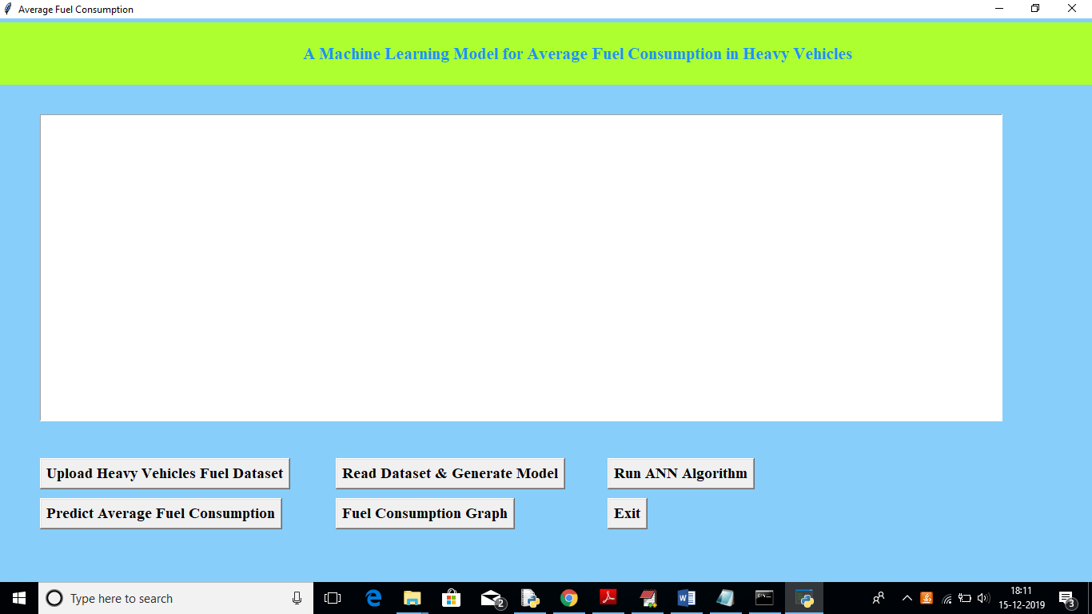
User Interface Design

Slide 14
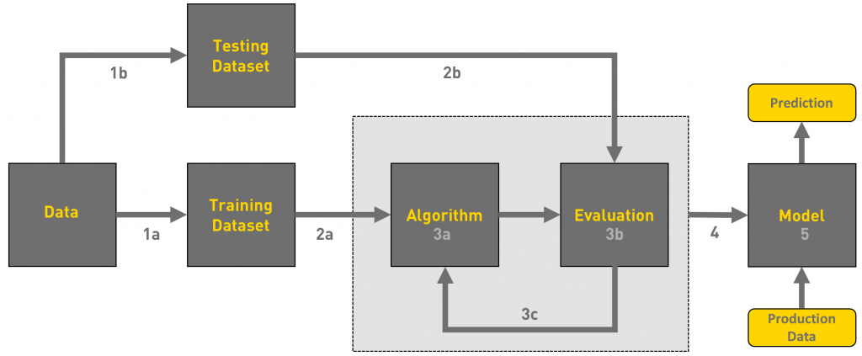
Architecture Design

Slide 15
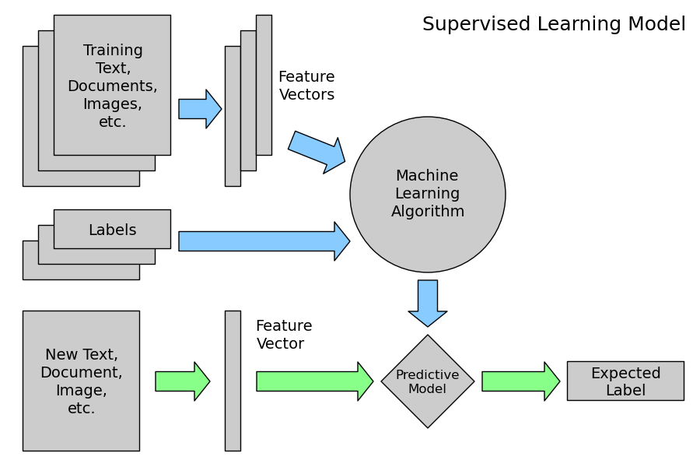
Component Design

Slide 16
Test Case
Use case ID | A Machine Learning Model for Average Fuel Consumption in Heavy Vehicles
Use case Name | Home Page
Description | Display home page
Primary actor | User
Precondition | User must open application
Post condition | Display the Home Page of an application
Frequency of Use case | Many times
Alternative use case | N/A
Use case Diagrams
Attachments | N/A

Slide 17
Test Case
Use case ID | A Machine Learning Model for Average Fuel Consumption in Heavy Vehicles
Use case Name | Upload Dataset
Description | Display Dataset page
Primary actor | User
Precondition | User must open application
Post condition | Display the Home Page of an application
Frequency of Use case | Many times
Alternative use case | N/A
Use case Diagrams
Attachments | N/A

Slide 18
Functional Requirements
Upload Heavy Vehicles Fuel Dataset
Read DataSet and Generate Model
Run ANN Algorithm
Predict average fuel consumption
Fuel Consumption Graph

Slide 19
Non-Functional Requirements
Python
tkinter

Slide 20
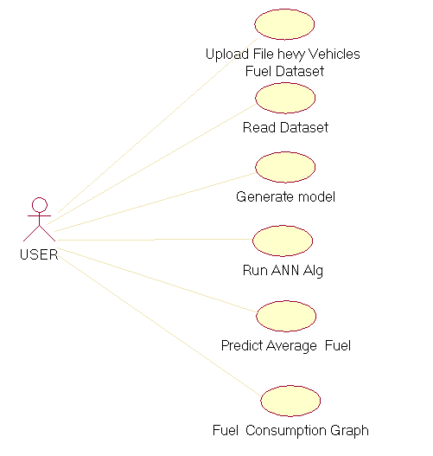
USECASE

Slide 21
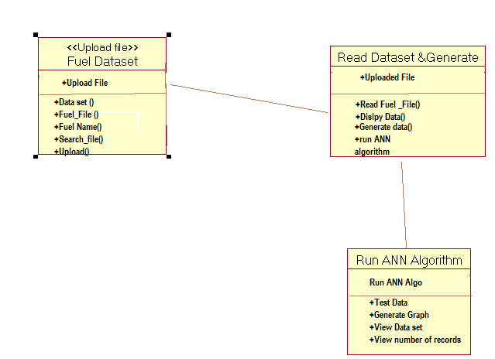
CLASS

Slide 22
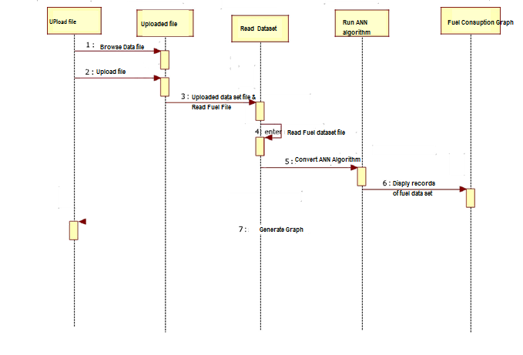
SEQUENCE

Slide 23
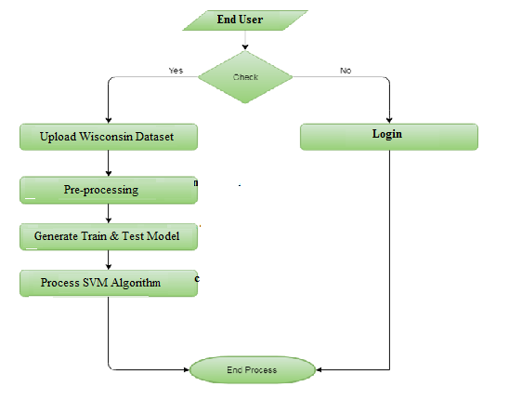
DFD

Slide 24
Data Dictionary
num_stops
time_stopped
average_moving_speed
characteristic_acceleration
aerodynamic_speed_squared
change_ in_kinetic_energy
change_in_potential_energy
We are using dataset

